Slide 1
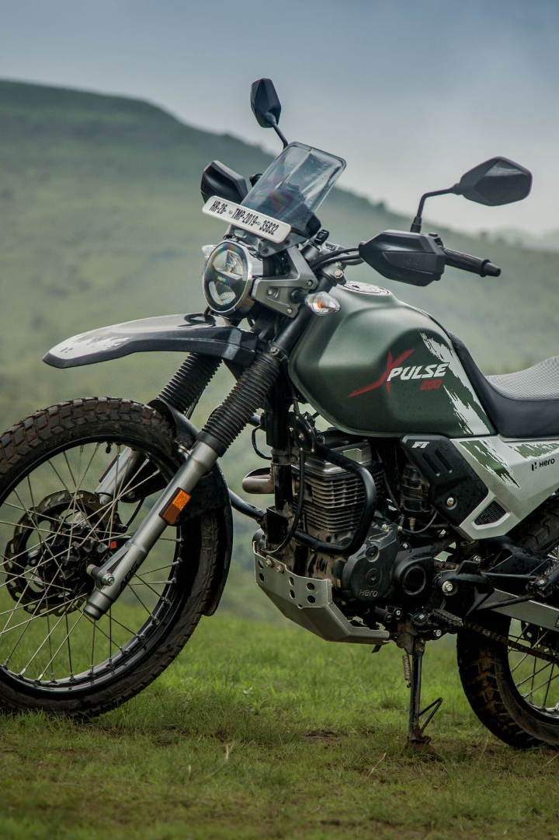
Adventure Works-Cycles
Adventure Works Cycles: Where Every Turn is Thrilling!

Slide 2


GROUP-3
Dhruva Darshan C
Adla Malasri
Shivarathri Karthik
Shubham Kumar
Jaya Surya Kumar
Mohammad Nazarudin Badi

Slide 3
Agenda
1
INTRODUCTION
2
KPI’s ANALYSIS
3
DASHBOARDS
4
SUGGESTIONS
5
CONCLUSION

Slide 4
Project Objective
Adventure Works Cycles, a multinational bicycle manufacturer headquartered in Bothell, Washington, aims to achieve several strategic objectives.
Firstly, they plan to bolster their market share by targeting and serving their most valuable customers effectively.
Secondly, they intend to broaden their product reach by launching an external e-commerce website, enabling them to reach a wider customer base and make their products more accessible.
Finally, the company is committed to improving cost-efficiency by streamlining manufacturing and supply chain processes, ultimately reducing production costs and enhancing overall profitability.
ExcelR Solutions
2023

Slide 5





Tools We Used:
5
ExcelR Solutions
2023

Slide 6








Overview
32 M
11 M
18,470
6
TOTAL SALES
TOTAL PROFIT
TOTAL CUSTOMERS
TOTAL COUNTRIES
36%
130
60,398
3
PROFIT PERCENTAGE
TOTAL PRODUCTS
TOTAL ORDERS
TOTAL CATEGORIES

Slide 7
Year wise Sales and Profit
2010
Sales : 0.05M
Profit : 0.02M
2012
Sales : 6.31M
Profit :2.28M
2014
Sales : 0.05M
Profit : 0.02M
2011
Sales : 7.64M
Profit : 2.67M
2013
Sales : 17.66
Profit : 6.36

Slide 8
Monthly Sales and Profit

Slide 9
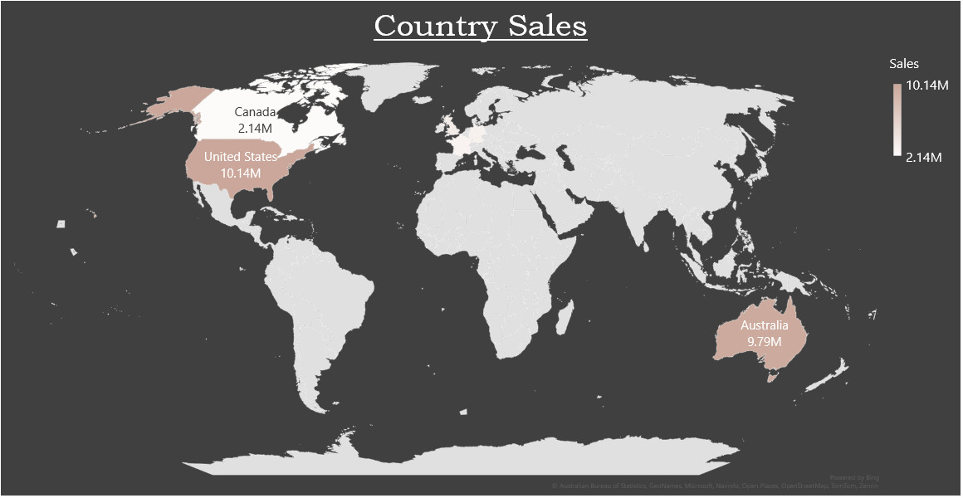
ExcelR Solutions
2023

Slide 10



Category
The "Bike“ category sales totaled $31 million with a $11 million profit. The highest bike sales occurred in 2013 between 2010 - 2014
The “Accessories" category generated 0.75M in sales with a 0.42M profit. The highest accessory sales occurred in 2013 between 2010 - 2014.
The “Clothing” category generated Sales $0.36M, with the Profit $0.12M. Highest accessory sales in 2013 from 2010-2014.
Bikes
Accessories
Clothing
ExcelR Solutions
2023

Slide 11
Bikes
Touring Bike
Road Bikes
Mountain Bikes
Accessories
Bike Racks
Bike Stands
Bottles and Cages
Cleaners
Fenders
Tires and Tubes
Helmets
Hydration Packs
Clothing
Caps
Gloves
Jerseys
Shorts
Socks
Vests

Slide 12




Customer Analysis
#of Customers
Men : 9349 Women : 9126
Single : 8469
Married : 10005
Bachelors : 5356
Partial HS : 1581
Single
Married
18470
ExcelR Solutions
2023

Slide 13
Age Group | Customers
20-30 | 1387
30-40 | 6747
40-50 | 5446
50-60 | 3400
60-70 | 1795
70-80 | 427
80-90 | 44
90-100 | 15
Total | 18470
Occupation
Clerical
2928
Management
3073
Manual
2384
Professional
5519
Skilled Manual
4576

Slide 14
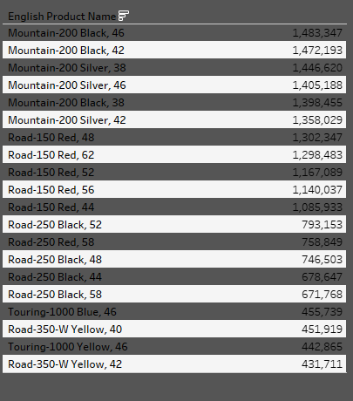
Product Analysis
Here we have our top 20 products which are sold across 6 countries, in which we can observe that Mountain-200 Black, 46 is the highest sold product.
With 505 products manufactured by the company, out of which only 130 products are purchased by the customers. So 375 products are there which are not sold at all.
14
ExcelR Solutions
2023

Slide 15

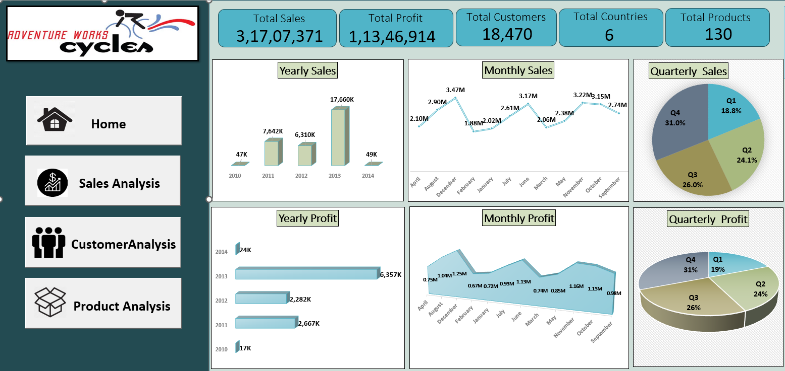
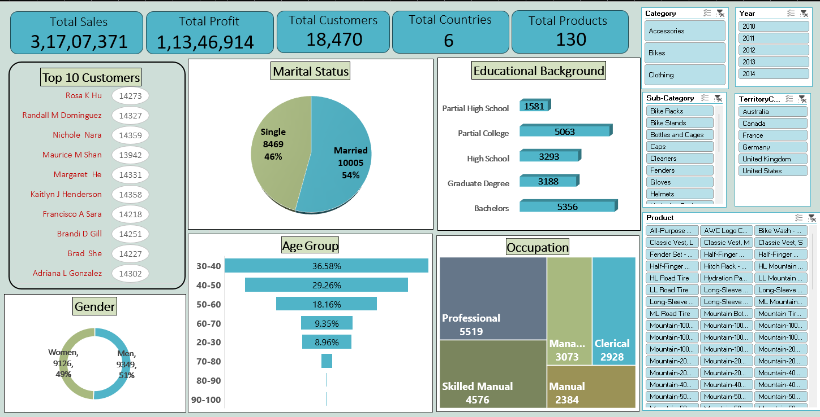
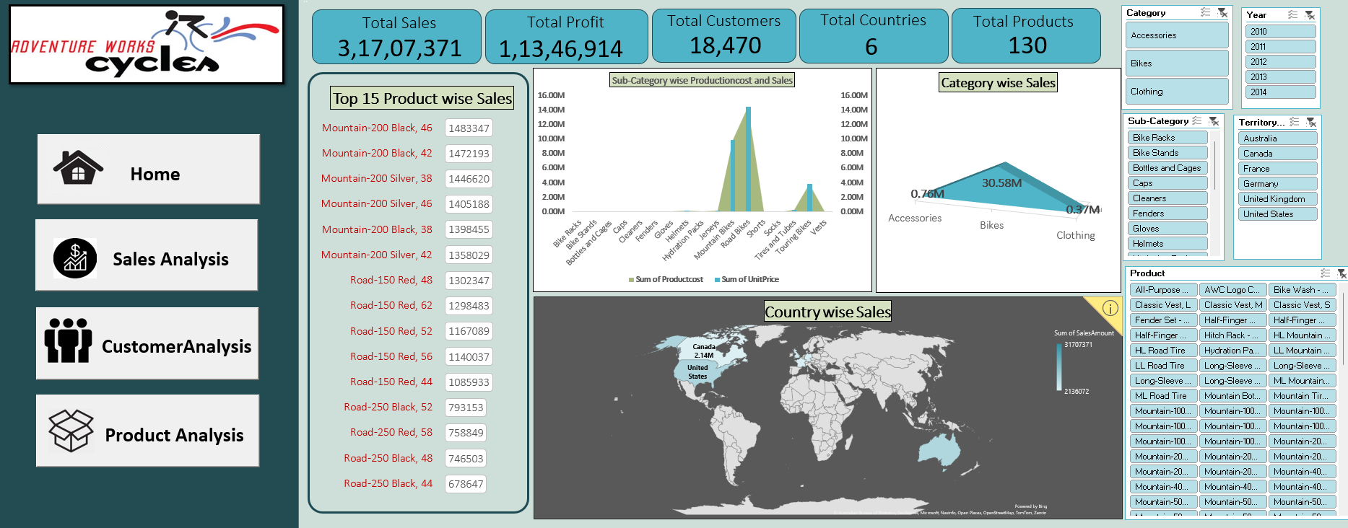
ExcelR Solutions
2023

Slide 16

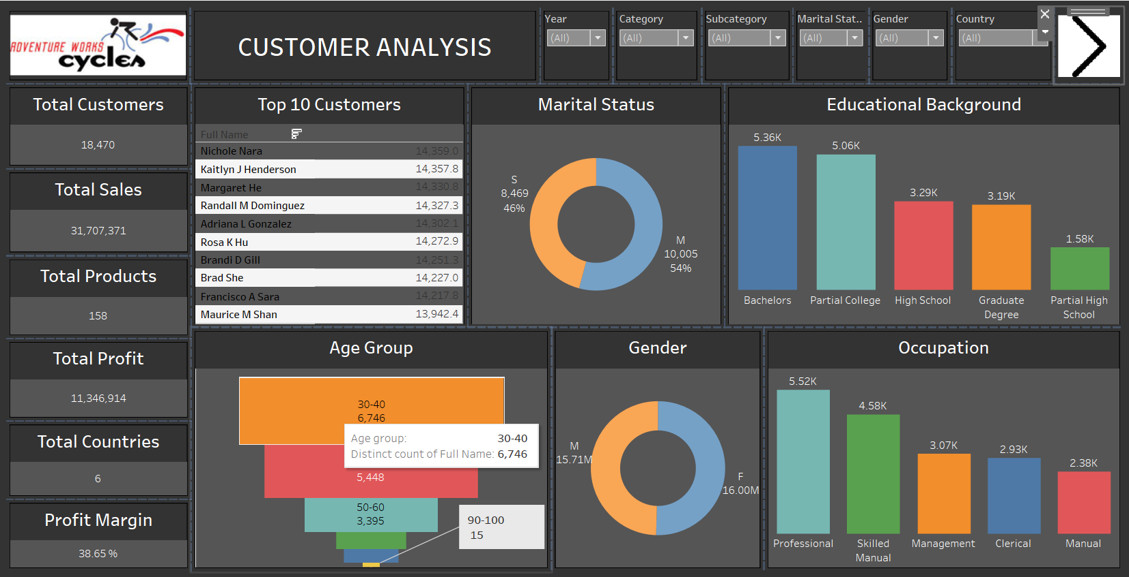
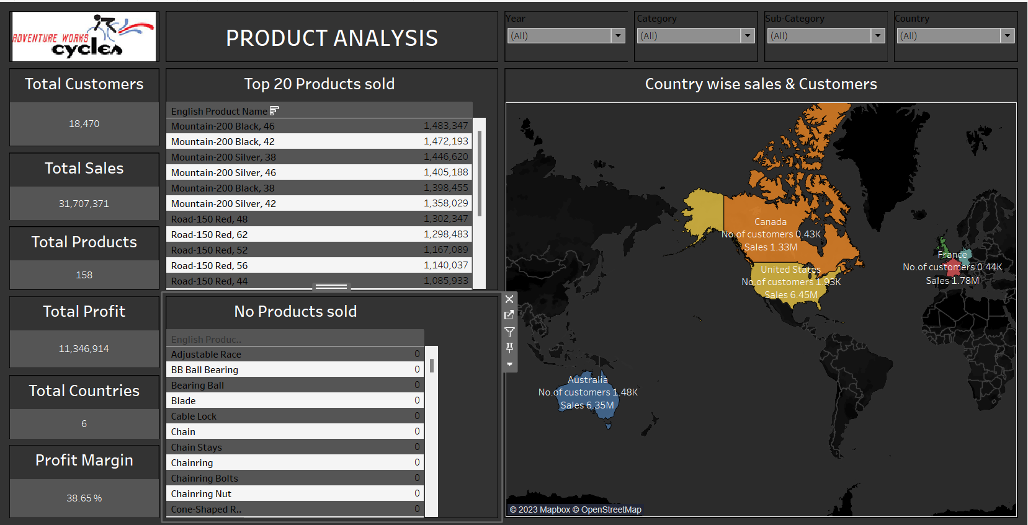
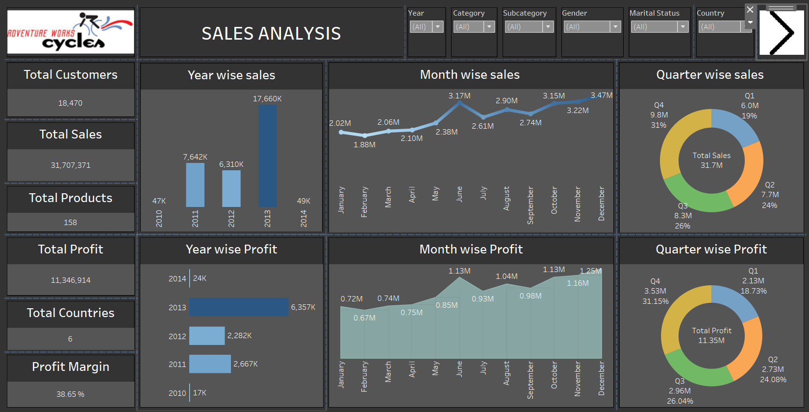
ExcelR Solutions
2023

Slide 17

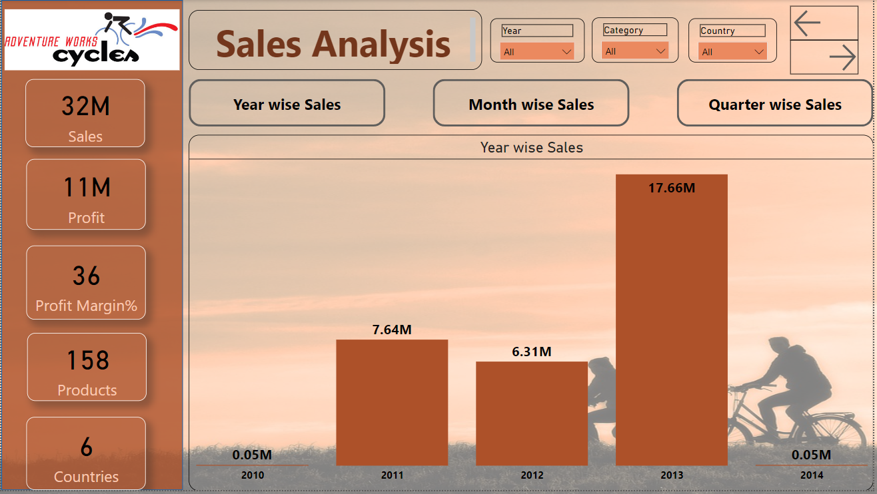
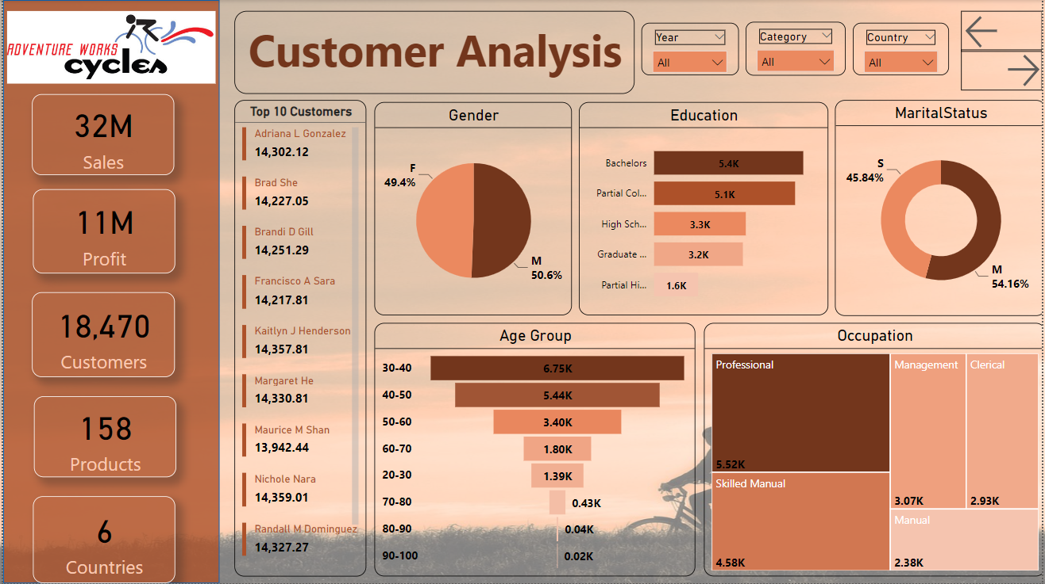
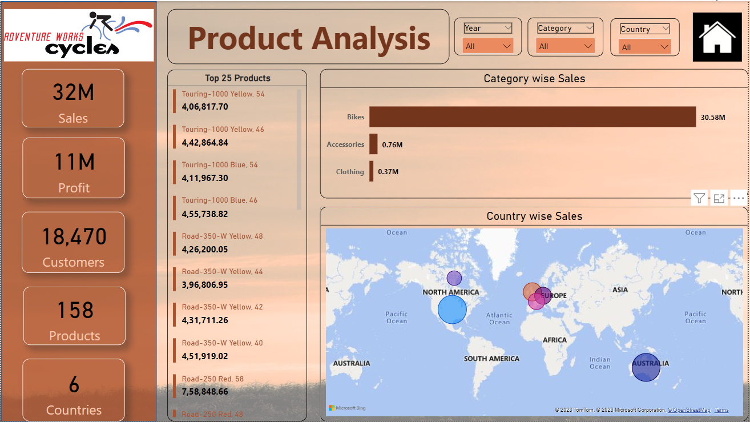
ExcelR Solutions
2023

Slide 18

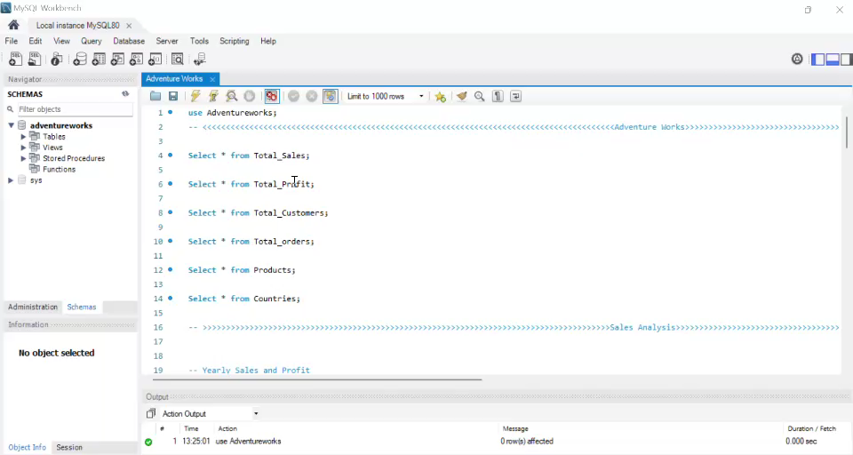
ExcelR Solutions
2023

Slide 19
SUGGESTIONS
Optimizing Operations:
Adventure Works manufactures a total of 505 products, with only 130 being purchased by customers, leaving 375 unsold. By strategizing to reduce production costs and reallocating resources, the company can optimize operations. With careful investment, it can potentially expand into smaller European or low-cost currency markets, maximizing revenue potential and broadening its global footprint.
Strategic
Initiatives:
Focus on market analysis to streamline product offerings, reducing unsold inventory. Invest in digital marketing for broader reach. Explore expansion into emerging markets with lower currency value to maximize profit. Innovate by introducing eco-friendly products to meet evolving consumer preferences.
ExcelR Solutions
2023

Slide 20

CONCLUSION
Adventure Works, a dynamic company, thrives on innovation and customer-centric solutions. With a dedicated team and a commitment to excellence, it continues to push boundaries in providing high-quality products and services. Its success lies in a blend of adaptability, vision, and a relentless pursuit of customer satisfaction.

Slide 21

Thank you

